Slide 1
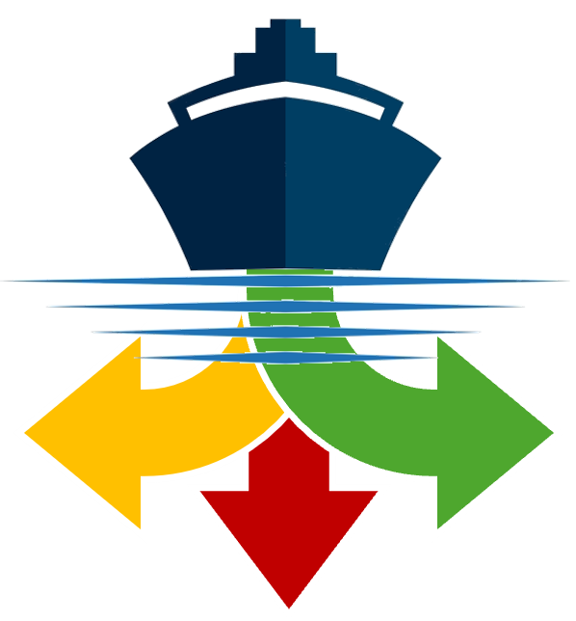




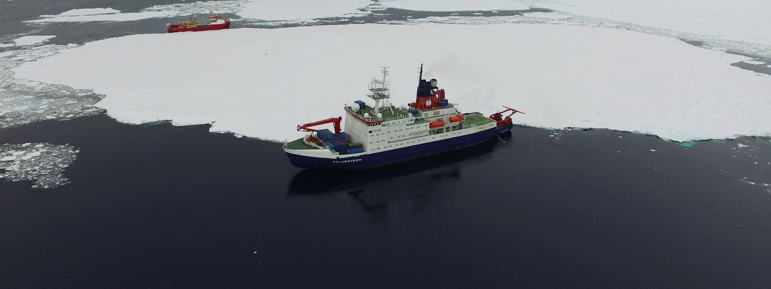





DestinE Sea Ice Decision Enhancement (DESIDE)
Photo: Andreas Cziferszky
Funded by the
European Union

Slide 2
Context
Objectives
Aggregating diverse information sources to provide common products across jurisdictional boundaries.
Producing new forecast products to improve decision-making by users.
Customizing delivery of products to different user communities based on their needs.
Drivers
Regulatory Compliance: Deliver short and medium-term forecasts of ice, meteorological, and ocean conditions, meeting the requirements of the IMO Polar Code.
Climate Change Effects: Provide long-term forecasts on changing ice and other conditions, enabling planning and policy development for the fishing, tourism, research, and oil and gas industries.

Slide 3
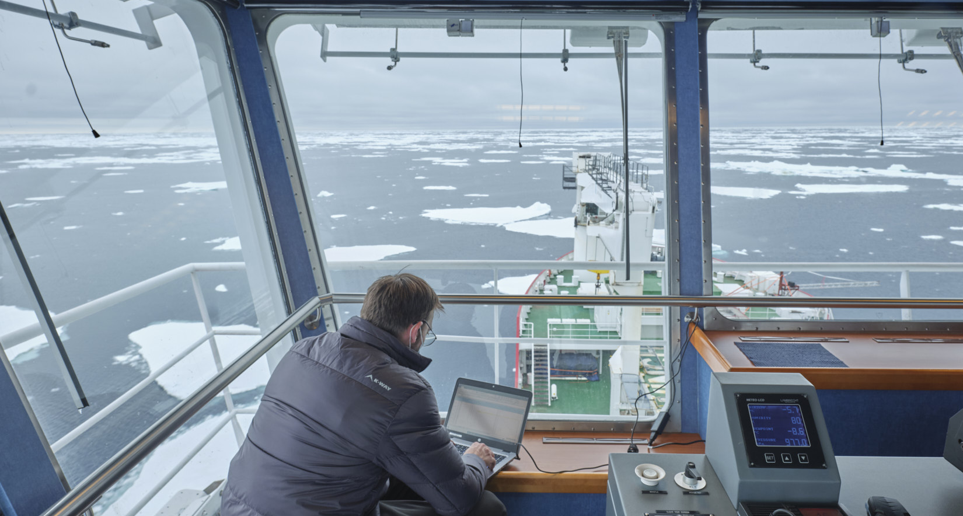
Benefits to Polar Operations and Society
Increased Safety: Accurate information supports strategic and tactical decision-making, enhancing safety of life and property.
Pollution Reduction: Efficient route optimization minimizes fuel consumption and emissions.
Protection of Sensitive Environmental Areas: Better forecasts can help policymakers protect environmentally sensitive areas affected by changing polar conditions.
Photo: Beat Rinderknecht

Slide 4
Decision Support Levels
The Use Case will demonstrate the added value of the DestinE system in supporting policy and decision making at three levels within the context of polar operations:
Execution support: supporting ships needing to avoid or navigate through sea ice.
Planning support: supporting ship operators in planning for polar voyages, guided by the information requirements of the IMO Polar Code.
Strategy and policy support: supporting organizations and policy analysts wanting to assess the impact of climate change on future decisions regarding polar operations.

Slide 5
Use Case Workflow
Data Ingestion: Collect past, current, and forecasted information on sea ice, snow thickness, icebergs, ocean currents and waves, wind, temperature, visibility, and Sentinel 1 imagery from DESP/DestinE.
Data Processing, Modeling, and Analysis: Use models, machine learning, and algorithms to process data for different user communities.
Information Product Generation: Create short, medium, and long-term sea ice charts, risk profiles, and route optimization suggestions for better decision-making.
Dissemination: through decision support platforms.

Slide 6
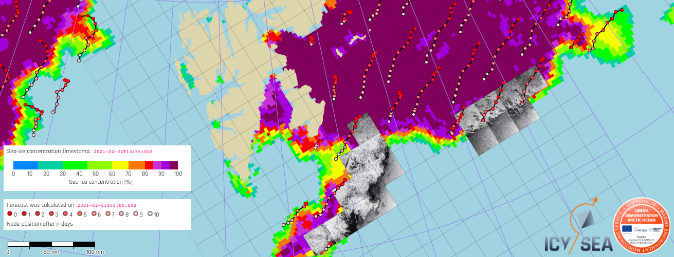
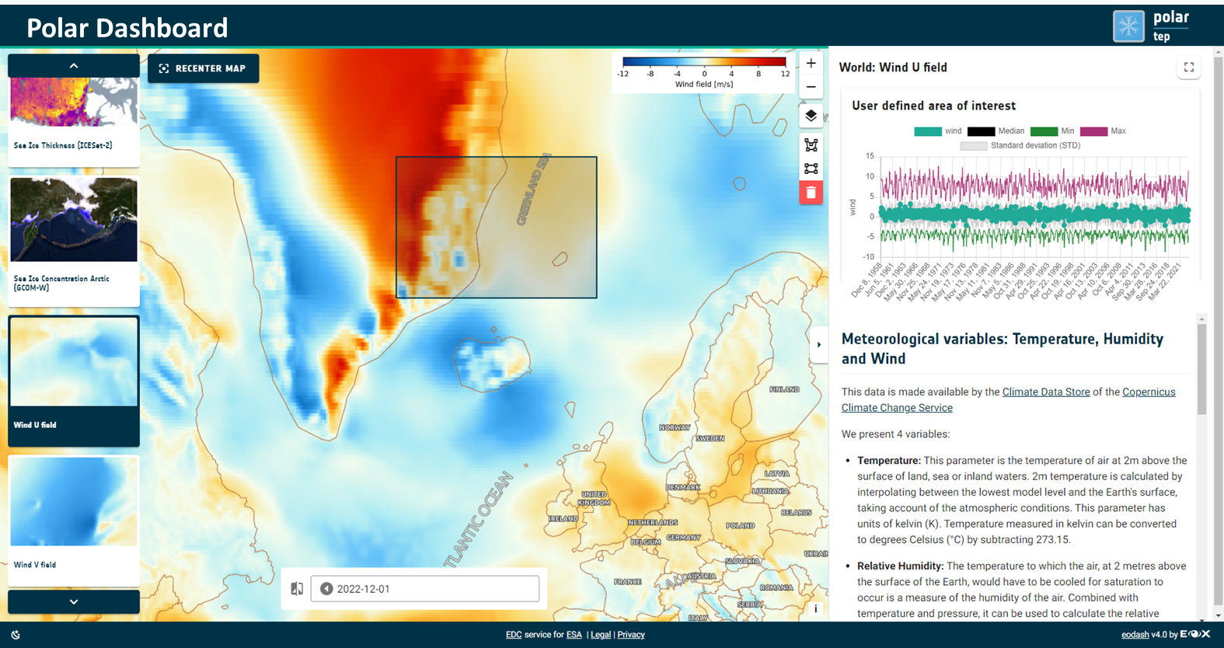
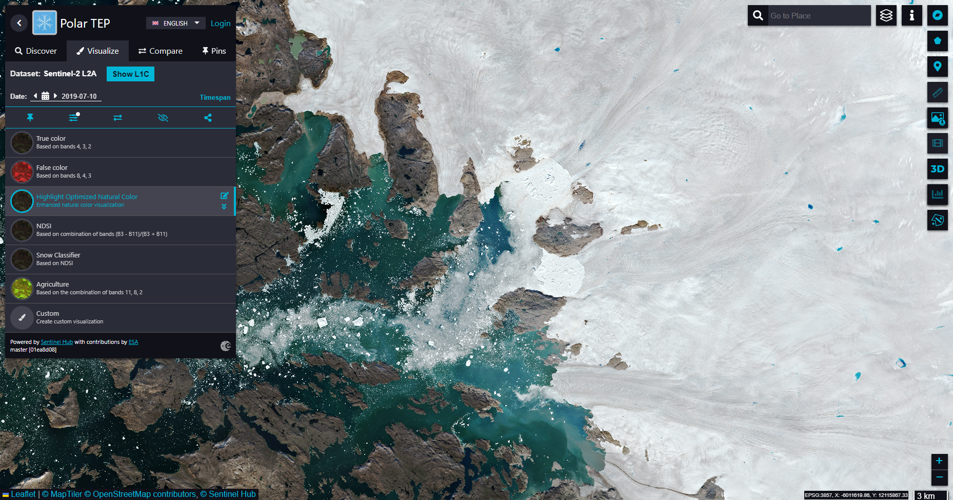
Decision Support Platforms
Decision support will be provided in three ways to meet the different needs and levels of sophistication of user groups:
IcySea: Tactical decision support for ships operating in polar regions.
Polar Dashboard: Strategic decision support for policy analysts and residents.
Polar TEP: Research collaboration platform for private, academic, and public sectors.

Slide 7
For More Information
David Arthurs
Managing Director
Polar View
Phone: +1 613 680 2282 x1
Email: david.arthurs@polarview.org
deside.polarview.org

